Slide 1

Time Series Prediction
On Electricity demand
(Random Forest and Facebook Prophet model)
-Xinyu Deng 1130058
-Yuantu Zhang 1129869

Slide 2

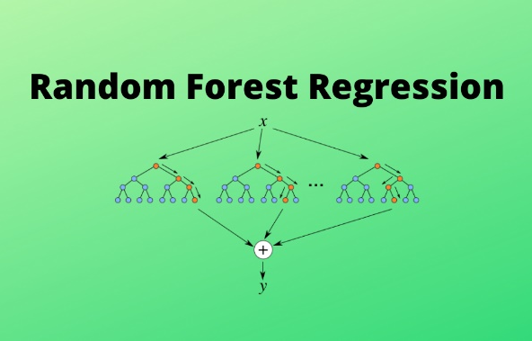

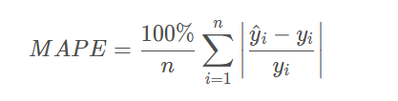
Goal
Modeling
Optimization
Evaluation
By adjusting the parameters, the prediction results are closer to the actual values
Mean Absolute Percentage Error（MAPE）
Notes:
Hello everyone, we are group 11, and our project is time series forecasting electricity demand using two models. The two models we use are Random Forest regression and Facebook Prophet. Our project aims to build the model with the datasets of the electricity demand of Victoria and forecast the future trend. Then we will try to optimize the result by adjusting the model's parameters. MAPE, which refers to 'mean absolute percentage error,' is used to evaluate the accuracy of the prediction. The smaller the value of MAPE, the better the prediction model will be. And We will compare the MAPE of 2 models after being optimized, figuring out which models suit this time series prediction scenario more. Next, let my partner introduce the dataset.

Slide 3

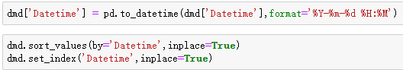
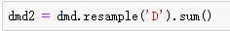


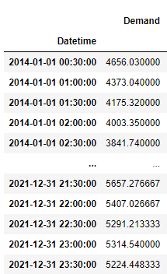
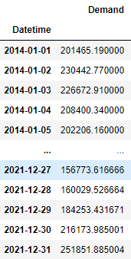
Dataset
VIC2014-2021:
Time series dataset of the electricity demand in MW for Victoria, Australia, every half hour from 2014 to 2021.
Source: AEMO (Australia Energy Market Operator).
Set to ‘datetime’ type
Train set:
2014-2020
Test set:
2021
(Forecast vs Actual)
resampling
Notes:
The dataset is the half-hourly electricity demand in MW of Victoria, Australia, from 2014 to 2021. We found the dataset on the AEMO, the Australia electricity market operator.
The dataset is firstly merged by excel. Then I convert the first column from ‘nonsense strings’ to the ‘datetime’: a specific data type that is understandable for the time series model. After this, I perform resampling to the dataset. Convert it from half-hourly to daily demand, reducing much of the computing.

Slide 4
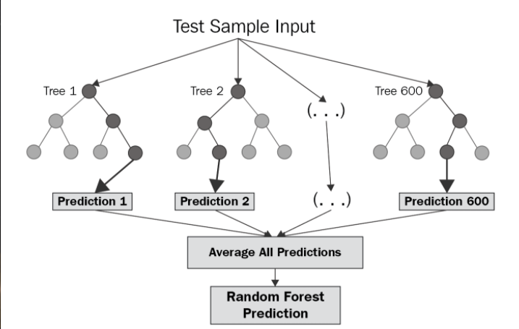
Random Forest Regression
1. Pick at random K data points from the training set
2. Build the decision tree associated with those K data point
3. Choose the number of trees you want to build and repeat step 1 &2
4. For a new data point, make each one of your Trees predict the value of Y for the data point, and assign the New data point the average across all of the predicted Y values.
A type of supervised learning algorithm that uses ensemble learning methods (bagging).
It operates by constructing multiple individual decision trees at training. Predictions from all trees are pooled to make the final prediction (mean of the prediction of the individual trees)
Notes:
1. Pick at random K data points from the training set
2. Build the decision tree associated with those K data point
3. Choose the number of trees you want to build and repeat step 1 &2
4. For a new data point, make each one of your Trees predict the value of Y for the data point, and assign the New data point the average across all of the predicted Y values.
一 It has an effective method for estimating missing data and maintains accuracy when a large proportion of the data are missing
二 It runs efficiently on large datasets

Slide 5
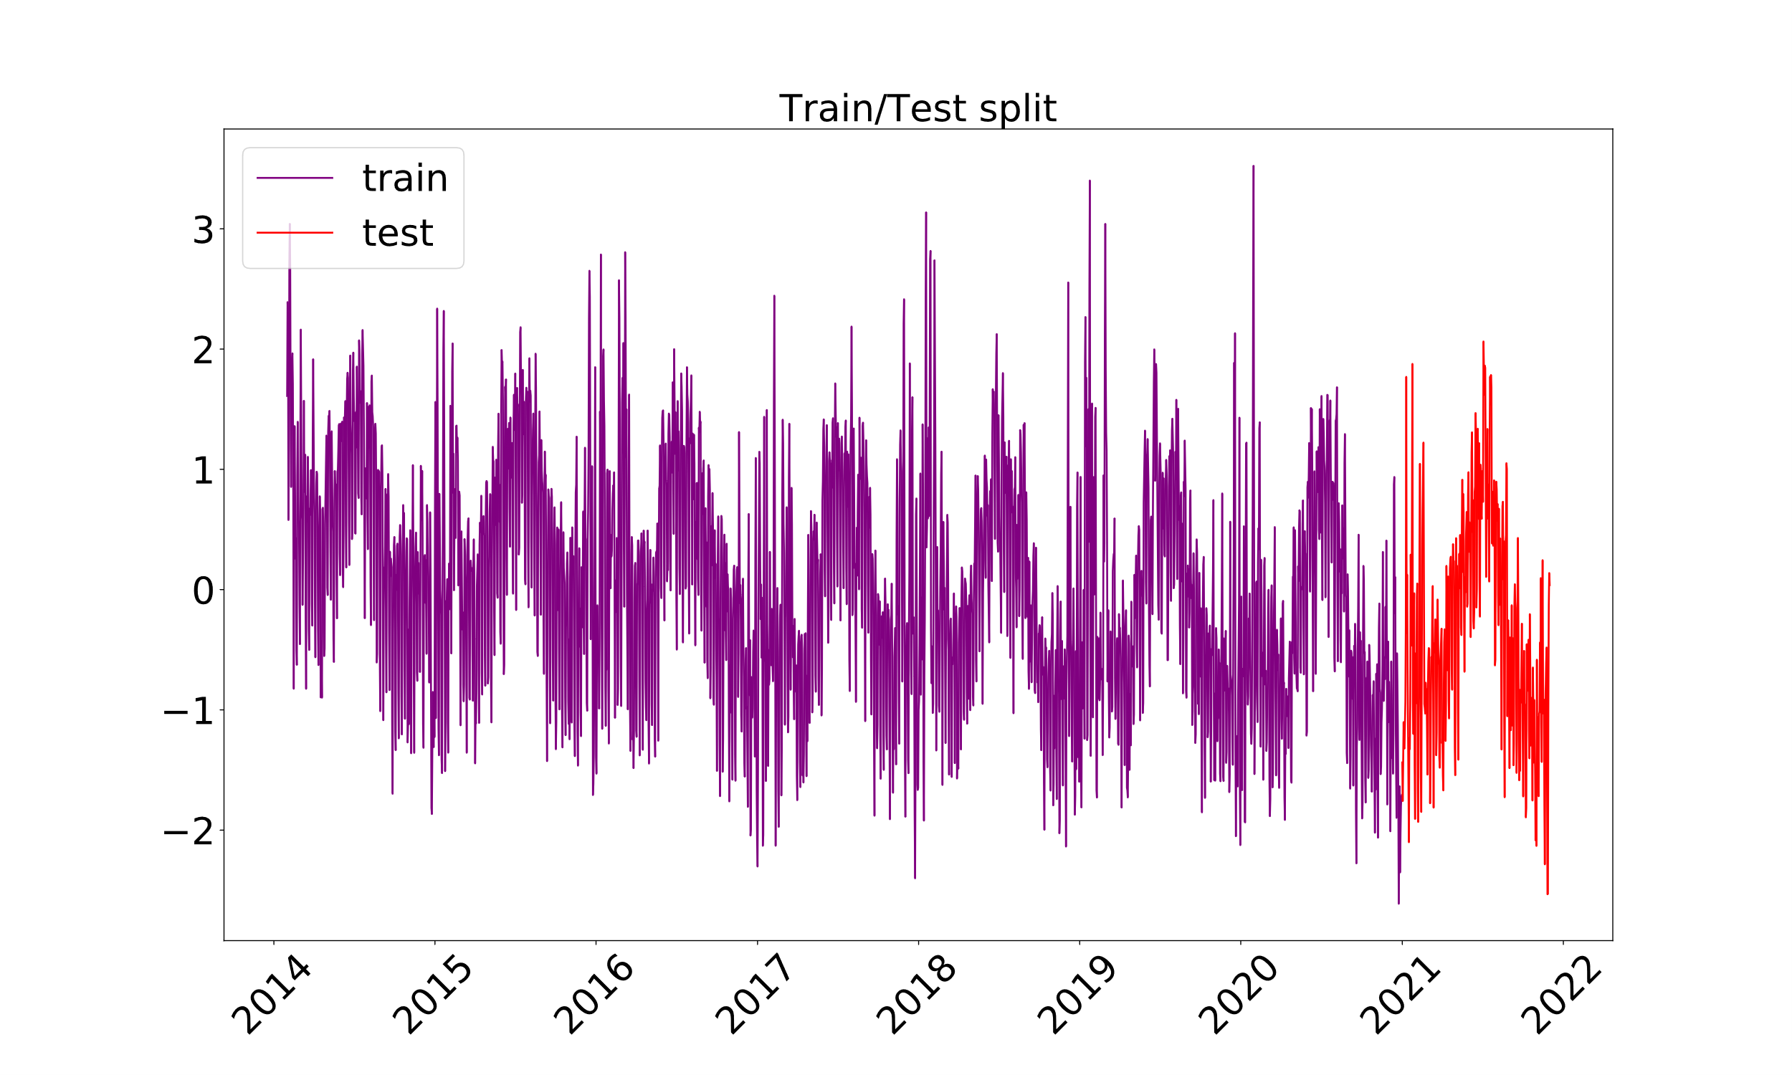
Random Forest
Time Split
The chart of the electricity demand shows seasonality, implying the time series is predictable.
Notes:
So as mentioned previously, I’m gonna spilt the datasets into two parts: training set and testing test. After that, we input the training set to the model constructor.

Slide 6
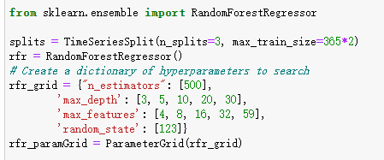
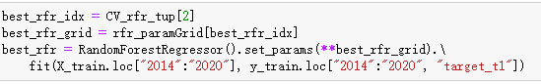
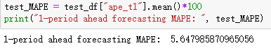
Random Forest
Modeling
Notes:
Now, we choose some parameters to iterate and try to get the parameter grid of best performance. When we get that, reconstruct the model and run it to see how it goes.

Slide 7
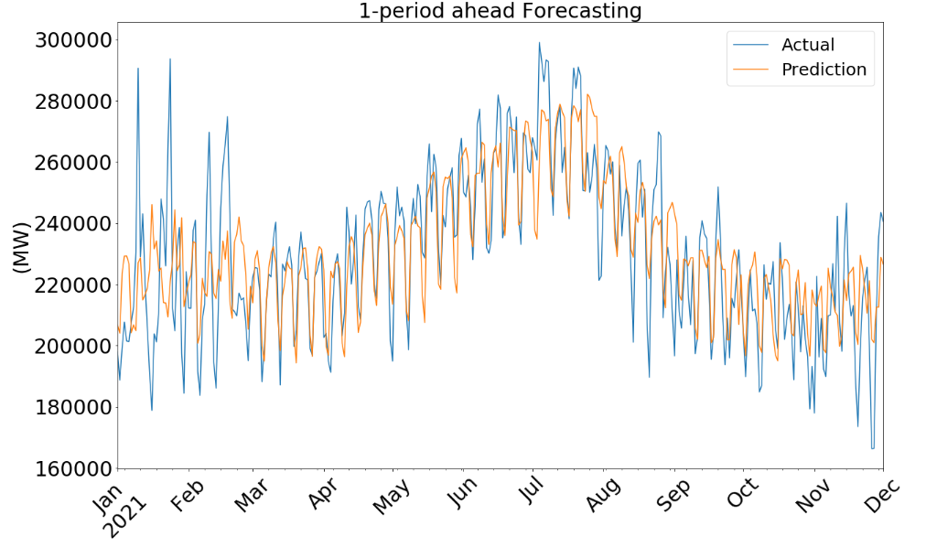
Random Forest
Result
Notes:
Now, the MAPE of the model is 5.64, and look at the line chart of the prediction vs actual, we can tell that generally it predict well, except for some points with a high fluctuation range.
However, it is just the beginning phase that we merely try a few parameters. We definitely haven’t reached the best one.

Slide 8
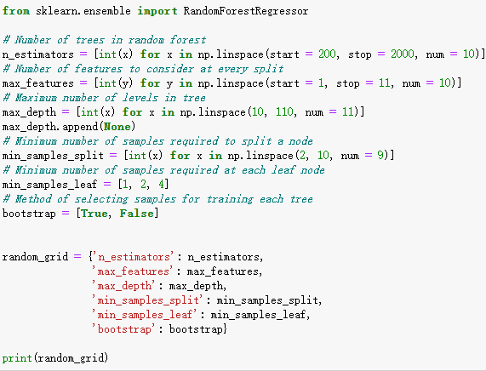
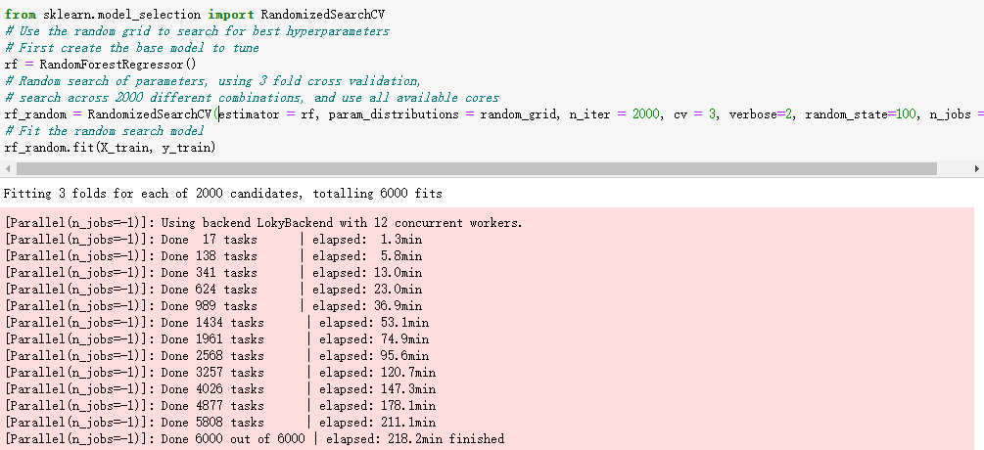
Random Forest
Optimization
Notes:
So if we iterate it all, it will be too much and time-consuming [nearly 60 thousands combin.] , so we utilize RandomizedSearchCV fcn to help us randomly select parts of them.
n_iter: controls the number of different combinations to try
cv: the number of folds to use for cross validation
cross-validation: when sampling, we split the sample into k sub-samples, leave a single sub-sample for validation and other K-1 sub-samples for training, and repeat the process K times.

Slide 9
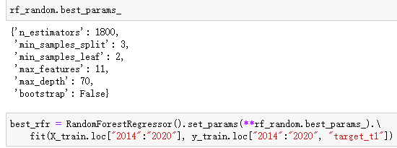
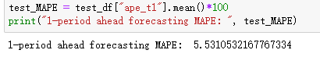
Random Forest
Re-modeling

Slide 10
Random Forest
Comparison
Optimization

Slide 11
Facebook Prophet model
An open-source time series forecasting algorithm from FaceBook
Predict future movements of time series fully automatically
Suitable for time series with strong seasonal influences
Notes:
The second model is Facebook Prophet. It is an open-source time series forecasting algorithm from Facebook that can handle not only the presence of some outliers in the time series, but also the case of partial missing values, and can also predict the future trend of the time series almost entirely automatically, especially suitable for time series with strong seasonal influences and several seasonal historical data.

Slide 12
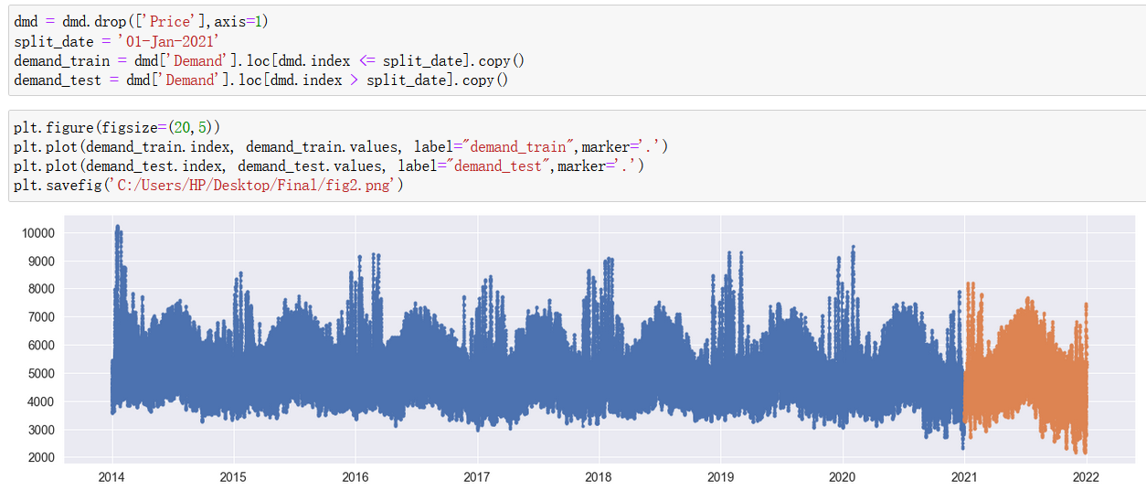
Facebook Prophet
Split data
Notes:
Similarly, we divide the dataset into two parts about the process. The data for 2014-2020 is for training, and the data for 2021 is for testing.
(Intro Code).

Slide 13
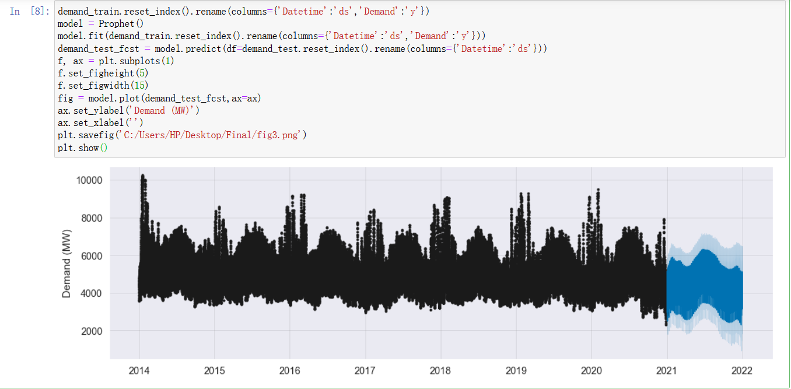
Result
Facebook Prophet
Notes:
After that, we reformat the training set. And then, we create a new model and put the training set as a parameter into the model. This is our result, we can see that the blue part at the end is the prediction given by the model after training, and the light blue area around is its confidence range, which means that the predicted value that falls in light blue is also acceptable. (Intro Code)

Slide 14
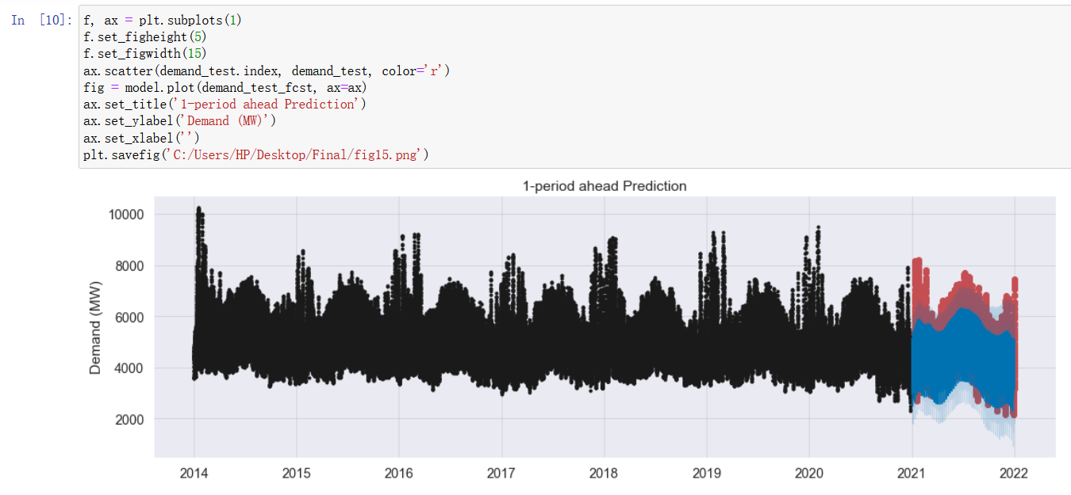
Comparison
Facebook Prophet
Notes:
We then import the test set and align it with the predicted part. Then we compare the prediction result (area in blue) with the actual value, and the parts that do not coincide are colored in red. We can see that their trends are broadly consistent. (Intro Code)

Slide 15
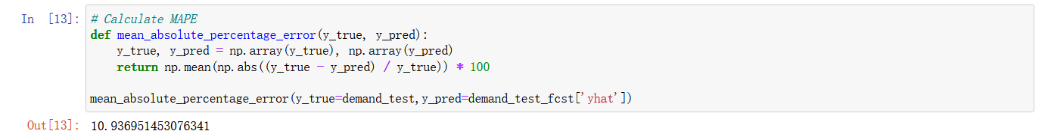
Facebook Prophet
MAPE of Evaluation
Notes:
Lastly, we calculate the MAPE value, which is around 10.93. Hence the prediction performance of the Facebook Prophet model is worse than the Random Forest Regression since the Random Forest regression model has a smaller MAPE value.

